Slide 1

Website requirements

Slide 2
Wordpress theme
http://preview.themeforest.net/item/softease-multipurpose-software-saas-product-template/full_screen_preview/16063405?_ga=2.22706427.1793962801.1534151261-609517514.1531645594
I will provide all text content needed and graphics/ images
No need for login pages or login functionality
Font is Roboto (Supported by the theme it supports google fonts)
All pages use white header on top not transparent
Breadcrumbs already supported in theme
In features / industries pages need Check other content document, it’s a big image slider with text on top for each image, text description on bottom for each image
Screenshots provided is from another unavailable theme
We just need to use the new theme that has same elements

Slide 3
Homepage

Slide 4

Homepage header links and structure of website
Change these as below:
1
homepage
Header links:
Product
Solutions
Resources
About
2
4
6
8
About us
Overview
Overview
Blog
Menu items
3
5
7
9
Pricing
Retail & e-commerce
Documentation
Contact us
Financial Services
Healthcare
Total unique pages = 9
Transportation and logistics
….

Slide 5
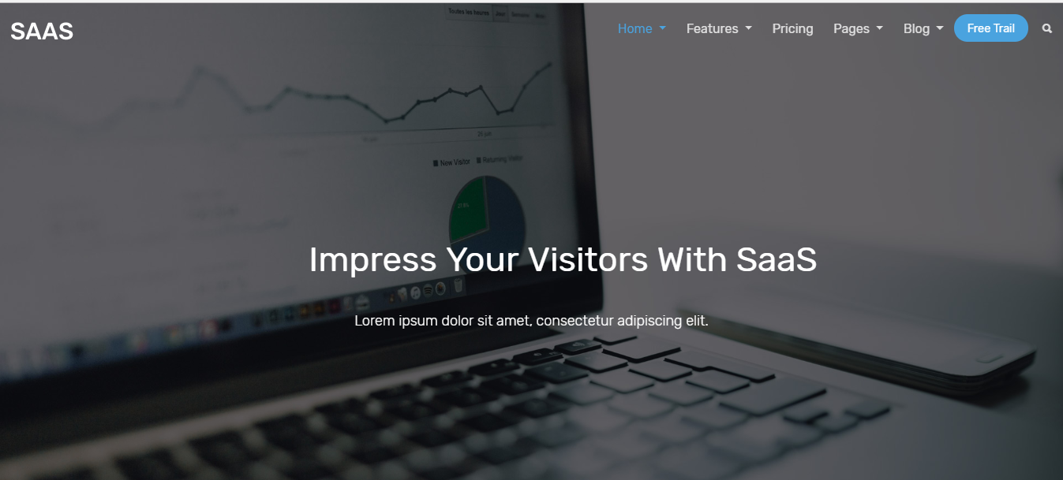

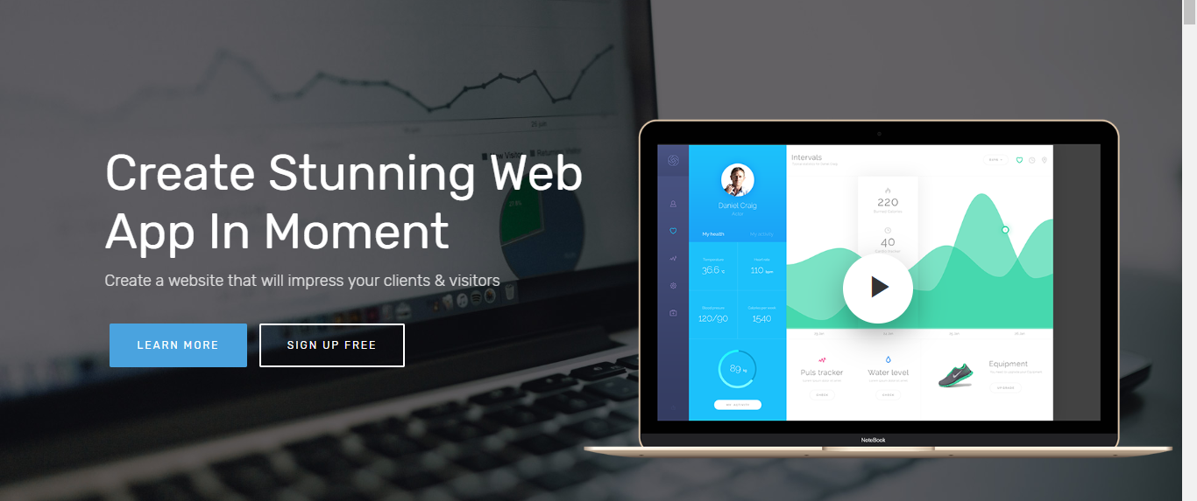
Homepage
Same type as in the theme “home video background”
http://bootstraplovers.com/bootstrap4/saas-v2.4/html/index-video.html
But it will be animated gif not a video link
Header links and menu items as in previous page
White header not the default transparent one
To show Animated gif not a video

Slide 6
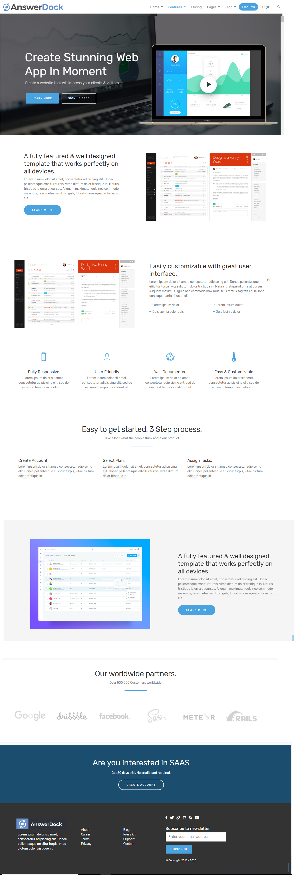
Rest of homepage
Check homepage mockup image
list of elements available in the theme (no need for any customization)
Will provide graphics and text content in detailed requirements
breadcrumb on every page
Elements are available in the theme
Animated gif will be provided, when clicking on it it expands full size
Footer same layout as theme with different links

Slide 7
Product pages

Slide 8
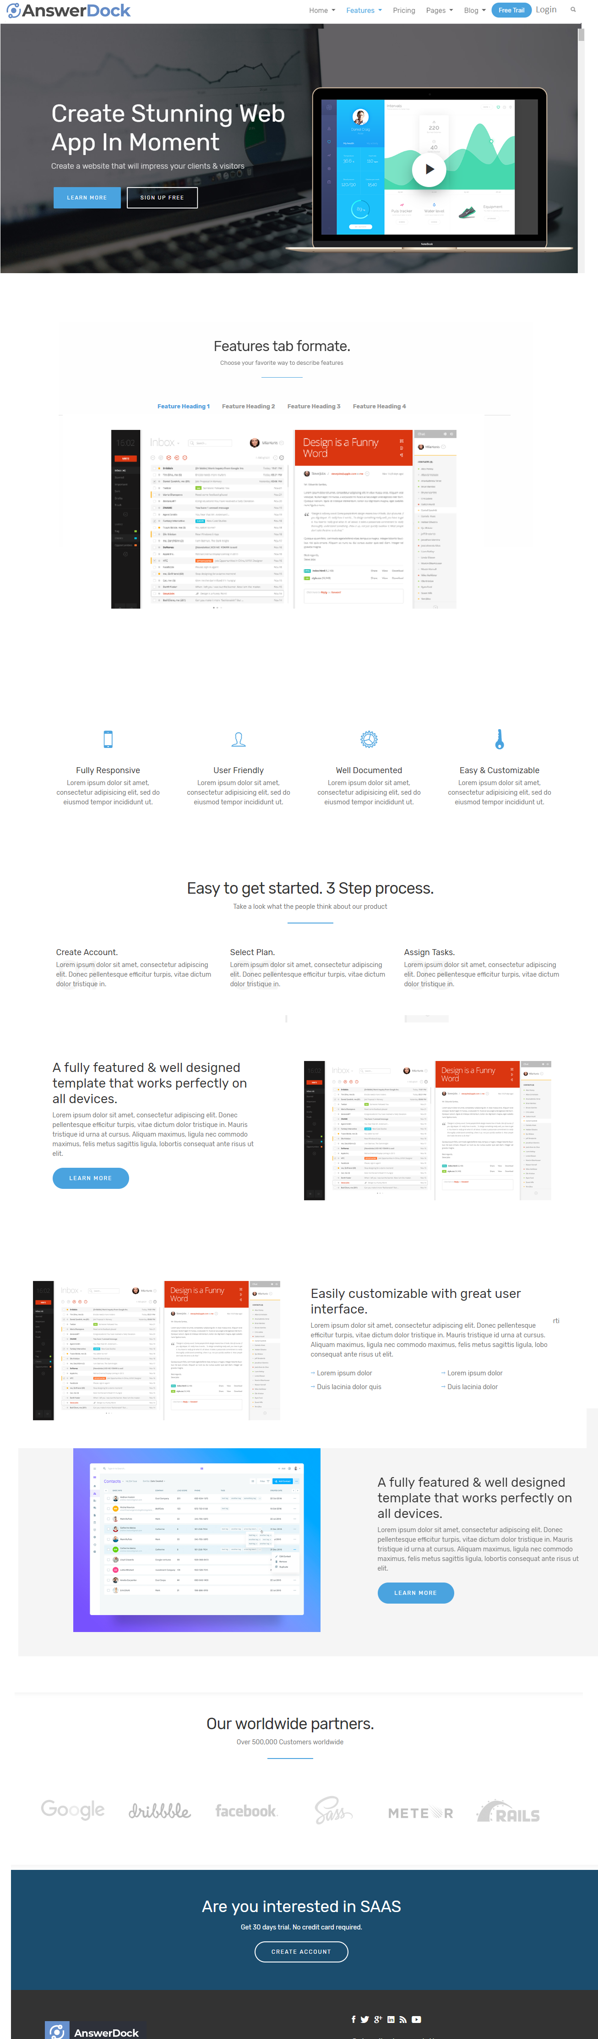
product>features
Check mockup image, its similar to homepage but without slider and has more content
Check other content document, it’s a big image slider with text on top for each image, text description on bottom for each image
Elements are available in the theme

Slide 9
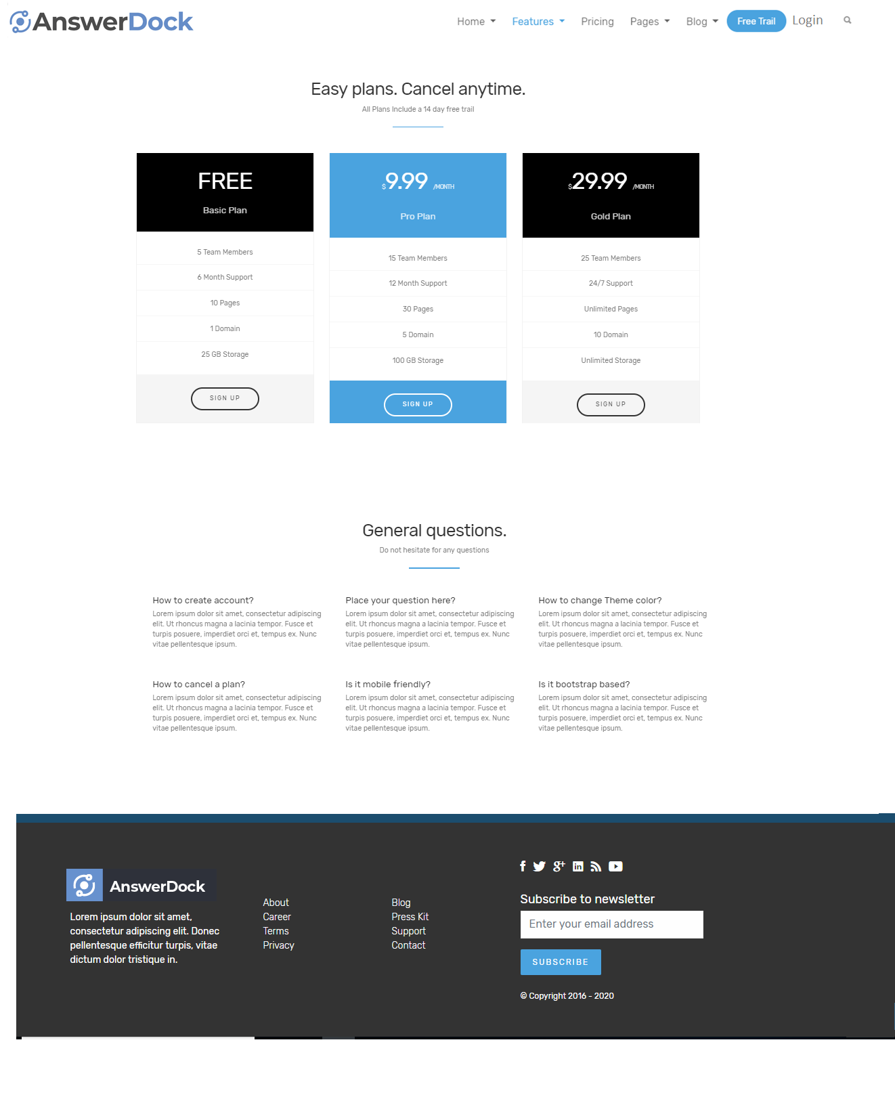
Product >pricing
http://bootstraplovers.com/bootstrap4/saas-v2.4/html/pricing.html
Elements are available in the theme
Faq element available

Slide 10
Solution pages

Slide 11
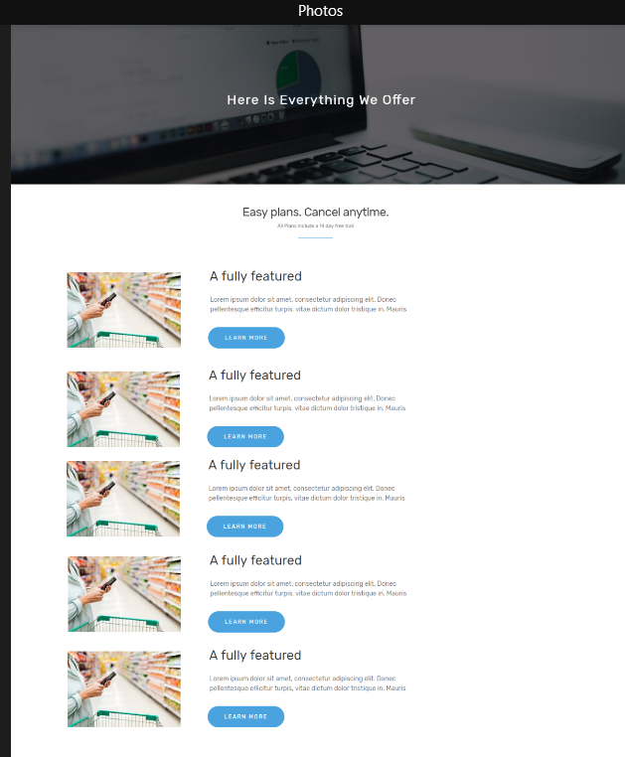
solutions >overview
Check solutions overview mockup
Use same style as in theme

Slide 12
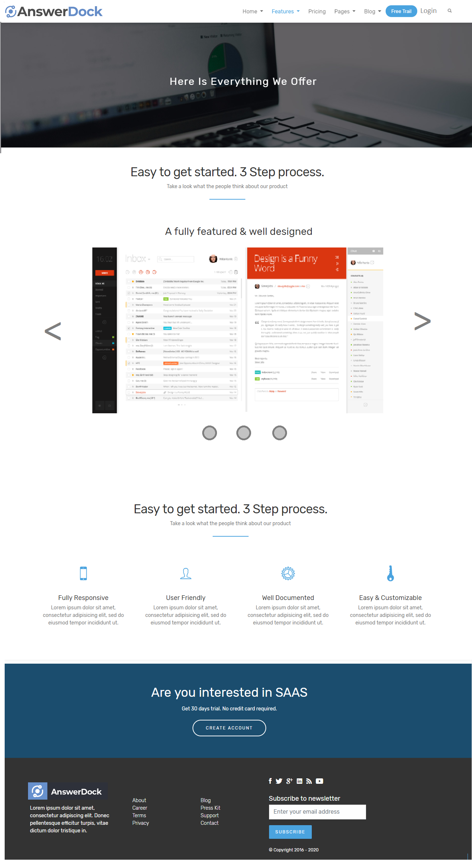
solutions >solution
~5 pages of same layout , different content and images…
Big image gif with title on top and slider navigation on bottom

Slide 13
Resources pages

Slide 14
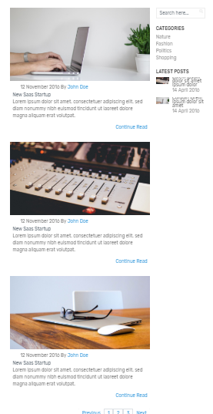
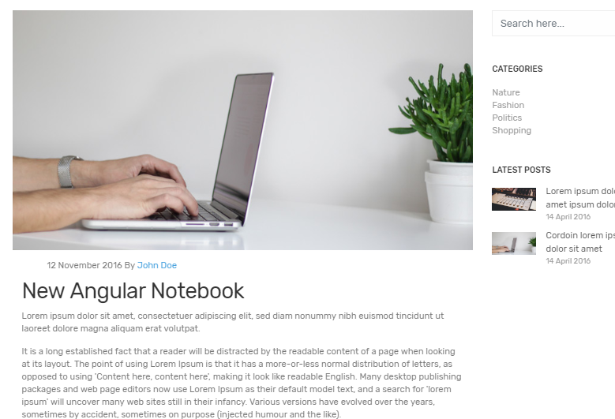
resources >blog articles listing + blog articles page
Exactly Same as here but without slider image
http://bootstraplovers.com/bootstrap4/saas-v2.4/html/blog-standard.html
blog articles listing
blog articles page

Slide 15
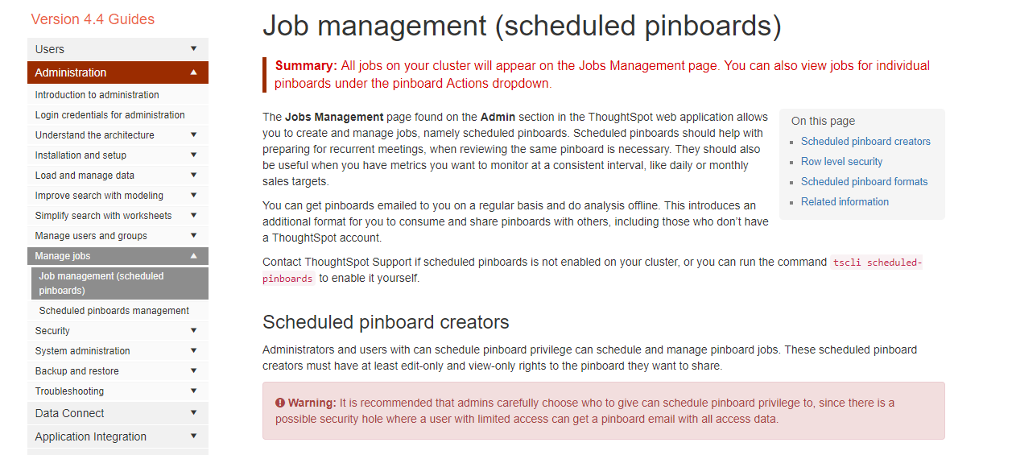
Resources > documentation
Same as blog pages but layout is tighter like this and menu is on the left
Ability to write articles in hierarchy with
Simple layout just header title, sub title, text.. Etc..
Left column layout available in theme
hirarchy links like this (every topic can have subtopics under it )
Heading 1
Heading 2
Heading3

Slide 16
About + Contact us

Slide 17
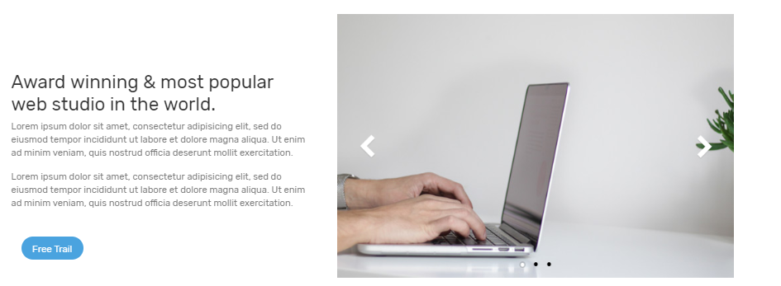
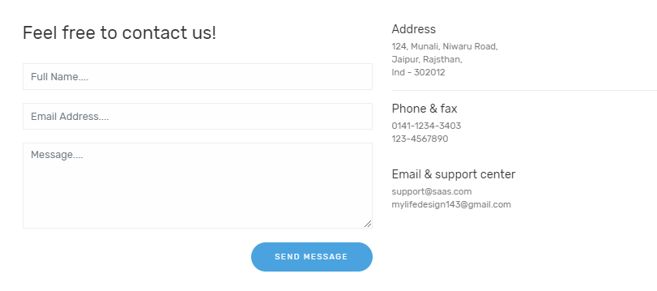
about> about us + contact us
About us
Contact us
http://bootstraplovers.com/bootstrap4/saas-v2.4/html/about.html
http://bootstraplovers.com/bootstrap4/saas-v2.4/html/contact.html
Page with one paragraph and one image, with contact us link
Contact us form will have more fields

